Slide 1

AI – ChatBot
Shri Shambhubhai V. Patel College of Computer Science
BCA Year 2024 - 2025
Developed By: Yash Dayani
Guided By: Prof. Bipin Jadav

Slide 2
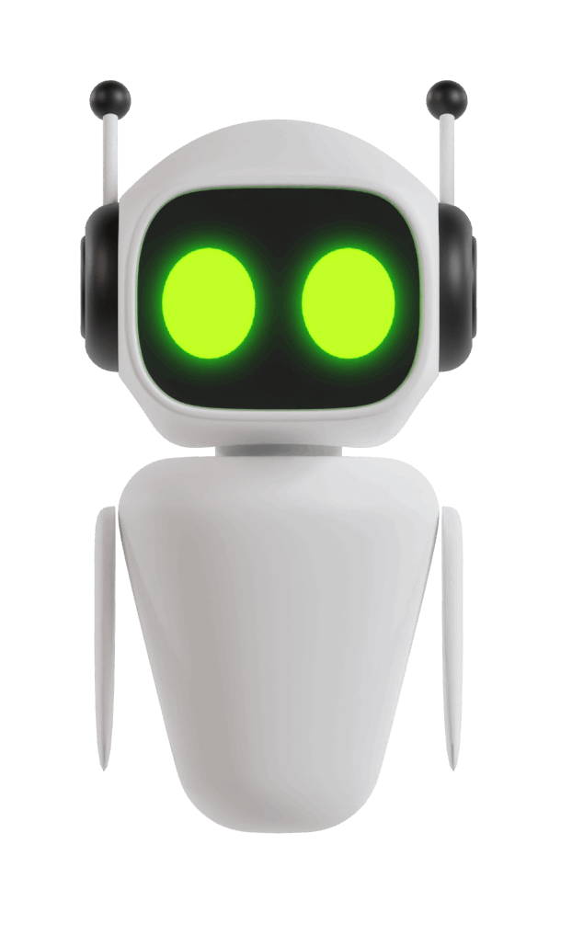
AI Chatbot
Transforming Queries into Conversations.

Slide 3

Introduction
This project is a web-based application designed to manage user authentication and track search history. It includes functionalities for user registration, login, and storing/searching user-specific queries and responses. The application is built using modern web technologies and follows best practices for security and performance.

Slide 4

Project Profile
Title | Summary
Project | AI Chat-Bot
Frontend | ReactJs
Backend | ExpressJs, NodeJs
Database | MongoDB
Project Guide | Prof. Bipin Jadav

Slide 5

AI Chat-Bot Need
These benefits make AI chatbots a valuable asset for an individual or an organizations
01
02
03
04
24/7 Availability
Cost Efficiency
Instant Responses
Task Automation

Slide 6

Objectives
These objectives help guide the development and implementation of the chatbot, ensuring it aligns with persons needs or goals.
1
Reduce Operational Costs
2
Automate Repetitive Tasks
3
Continuous Learning and Improvement
4
Data Analysis

Slide 7
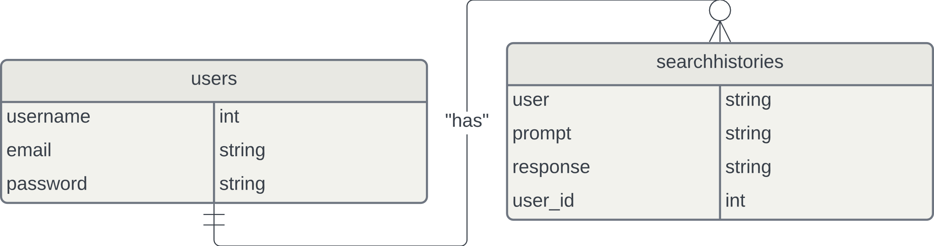
ER DIAGRAM

Slide 8
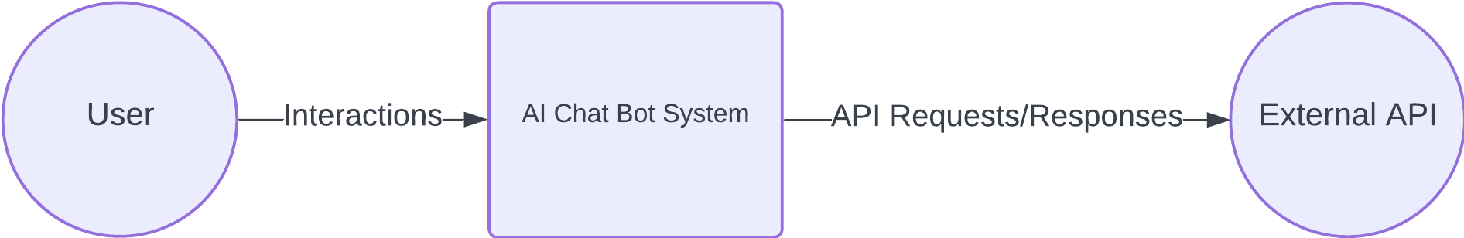
LEVEL-0 DFD

Slide 9
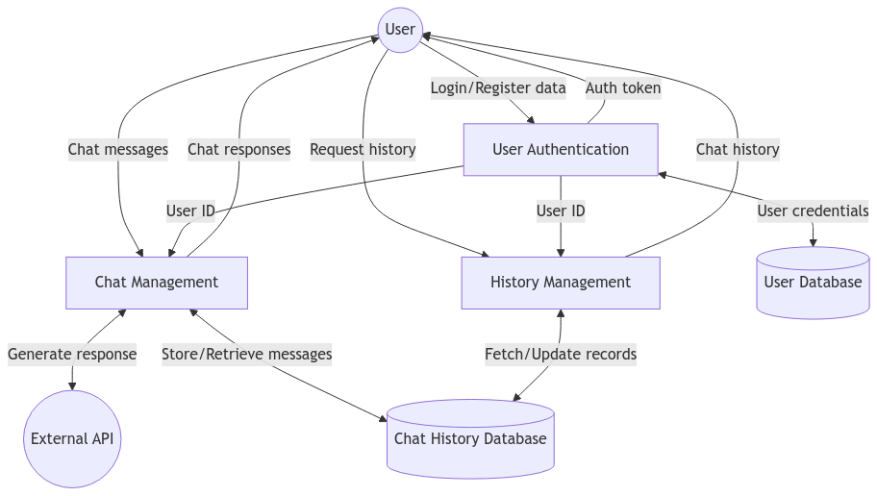
LEVEL-1 DFD

Slide 10
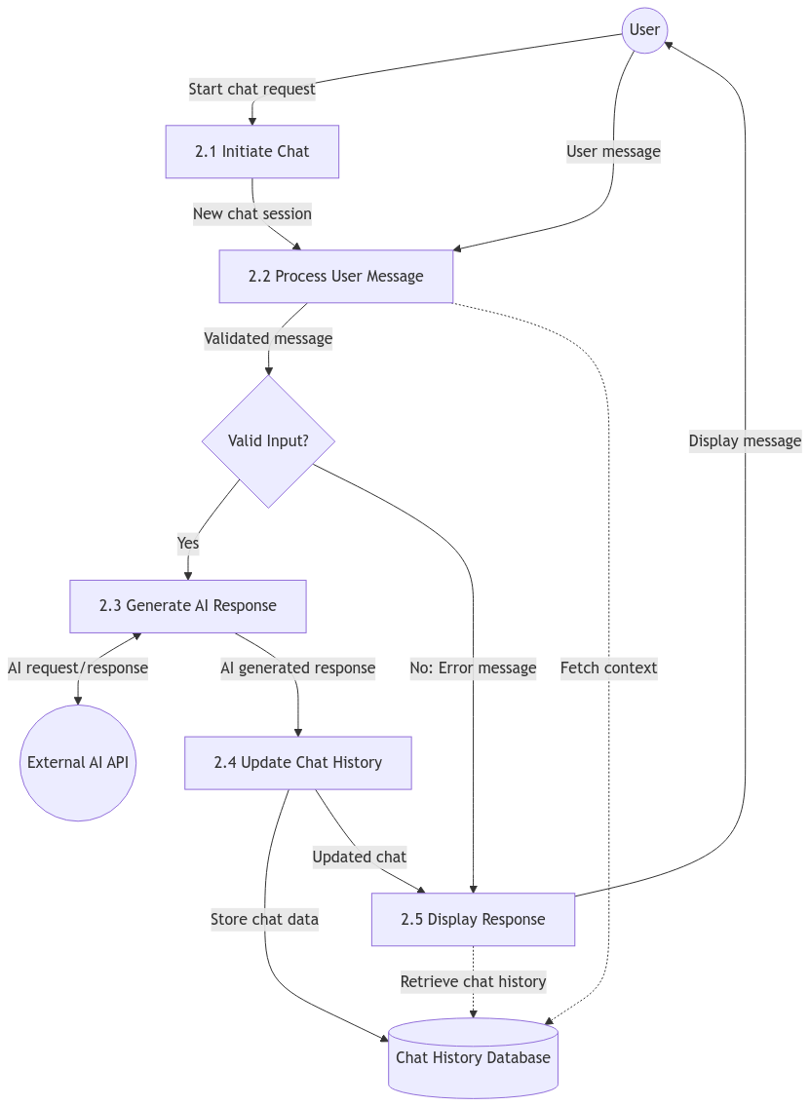
LEVEL-1 DFD

Slide 11
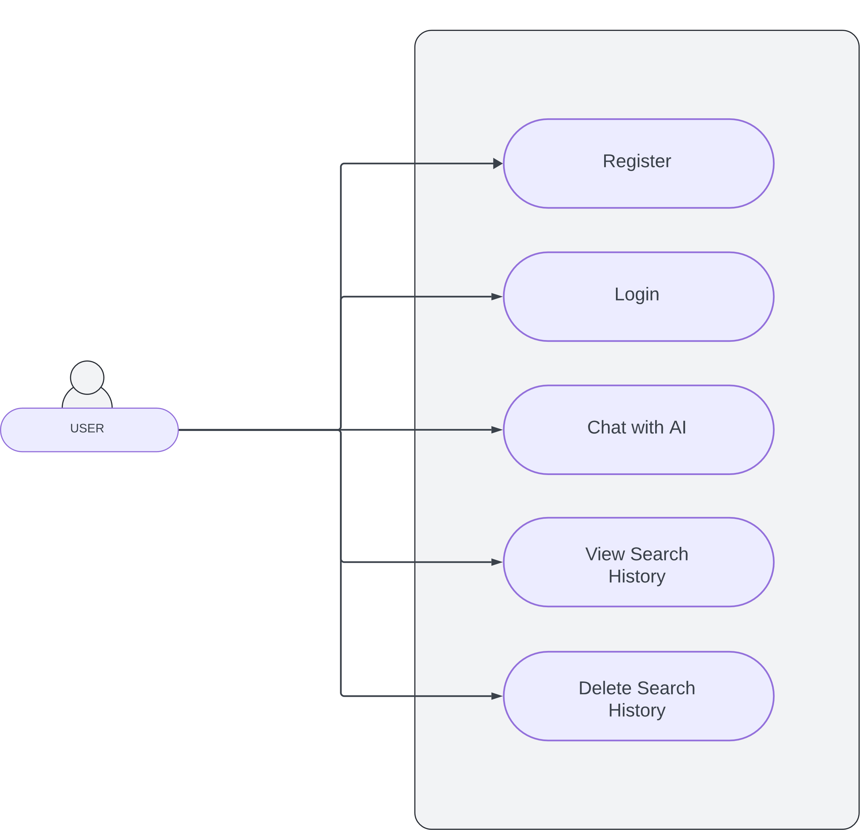
USECASE DIAGRAM

Slide 12
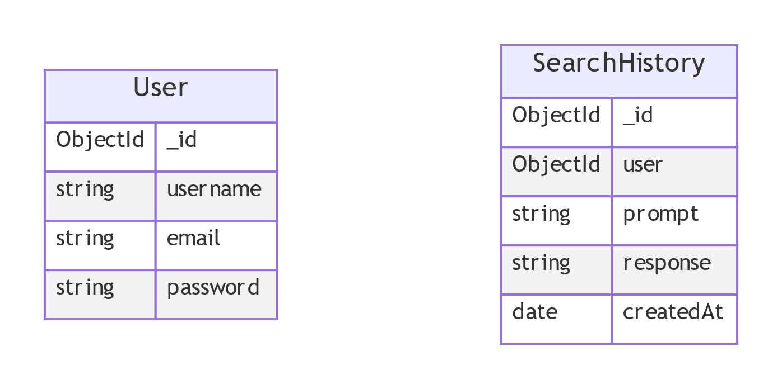
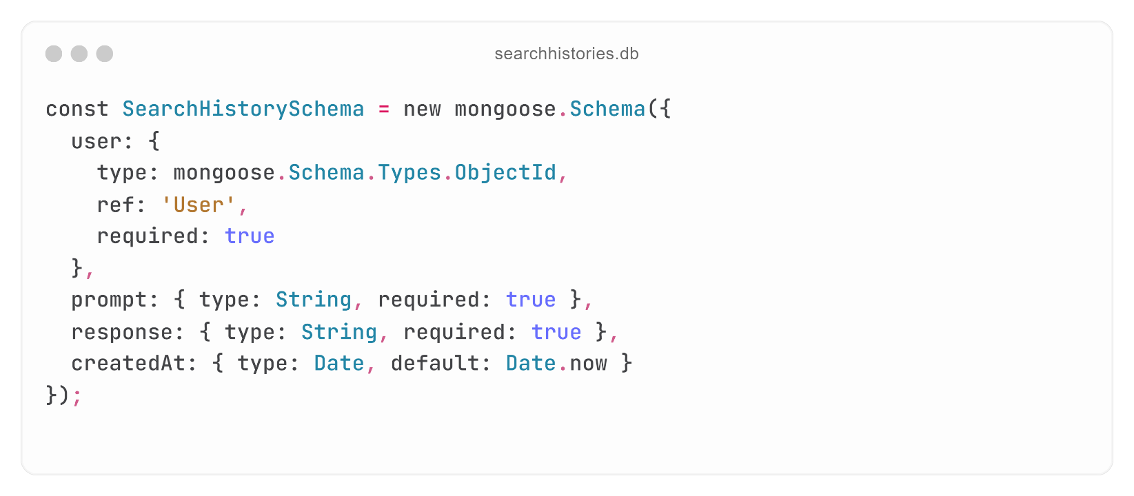
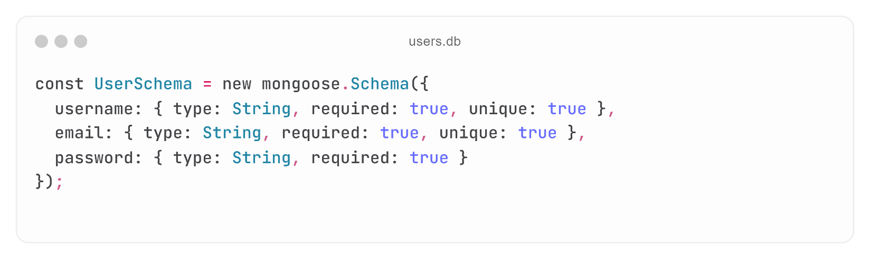
DATABASE DESIGN

Slide 13
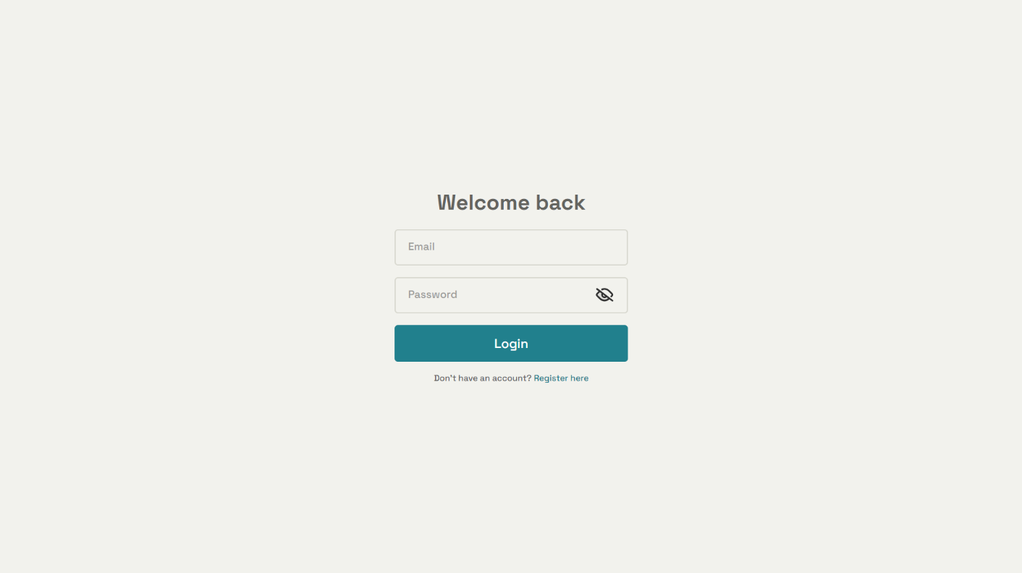
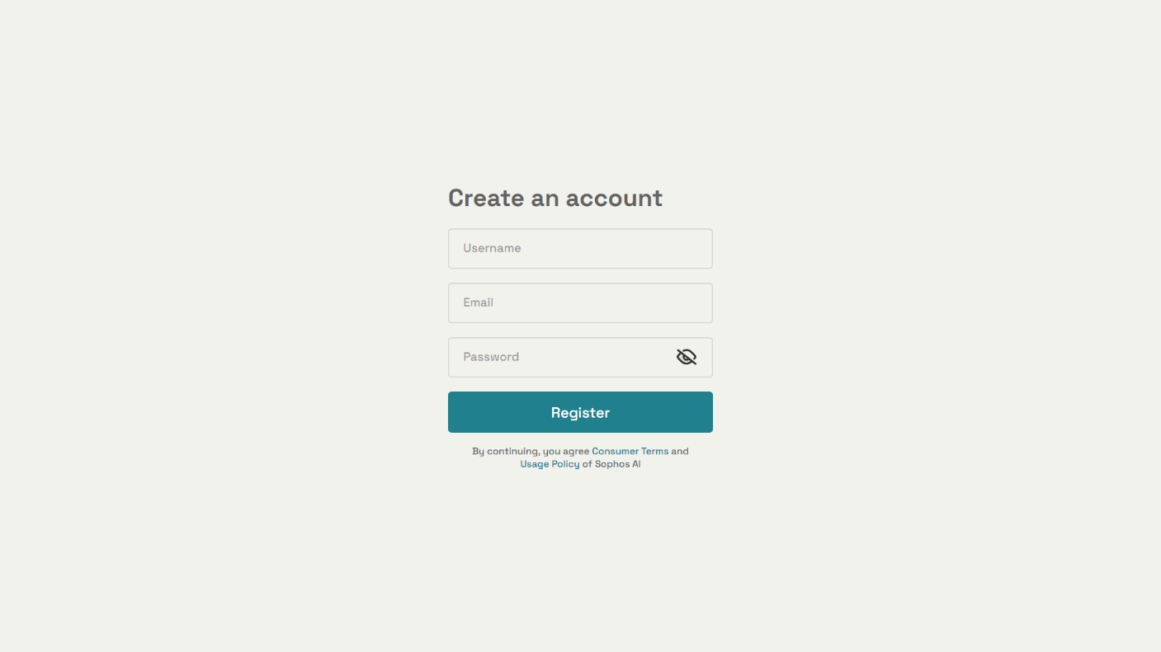
Login & Registration

Slide 14
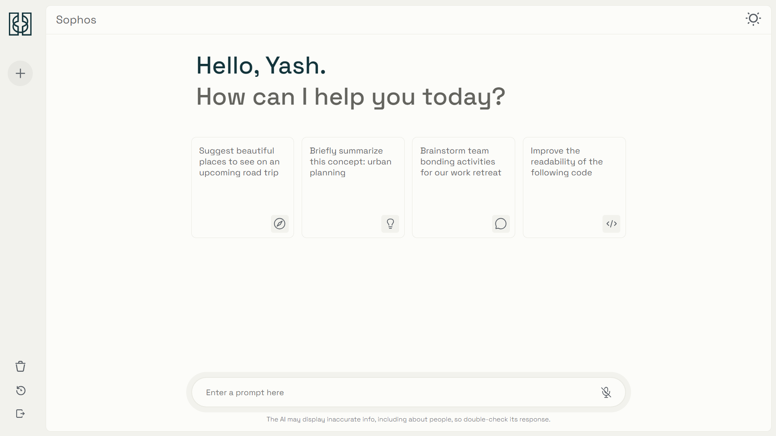
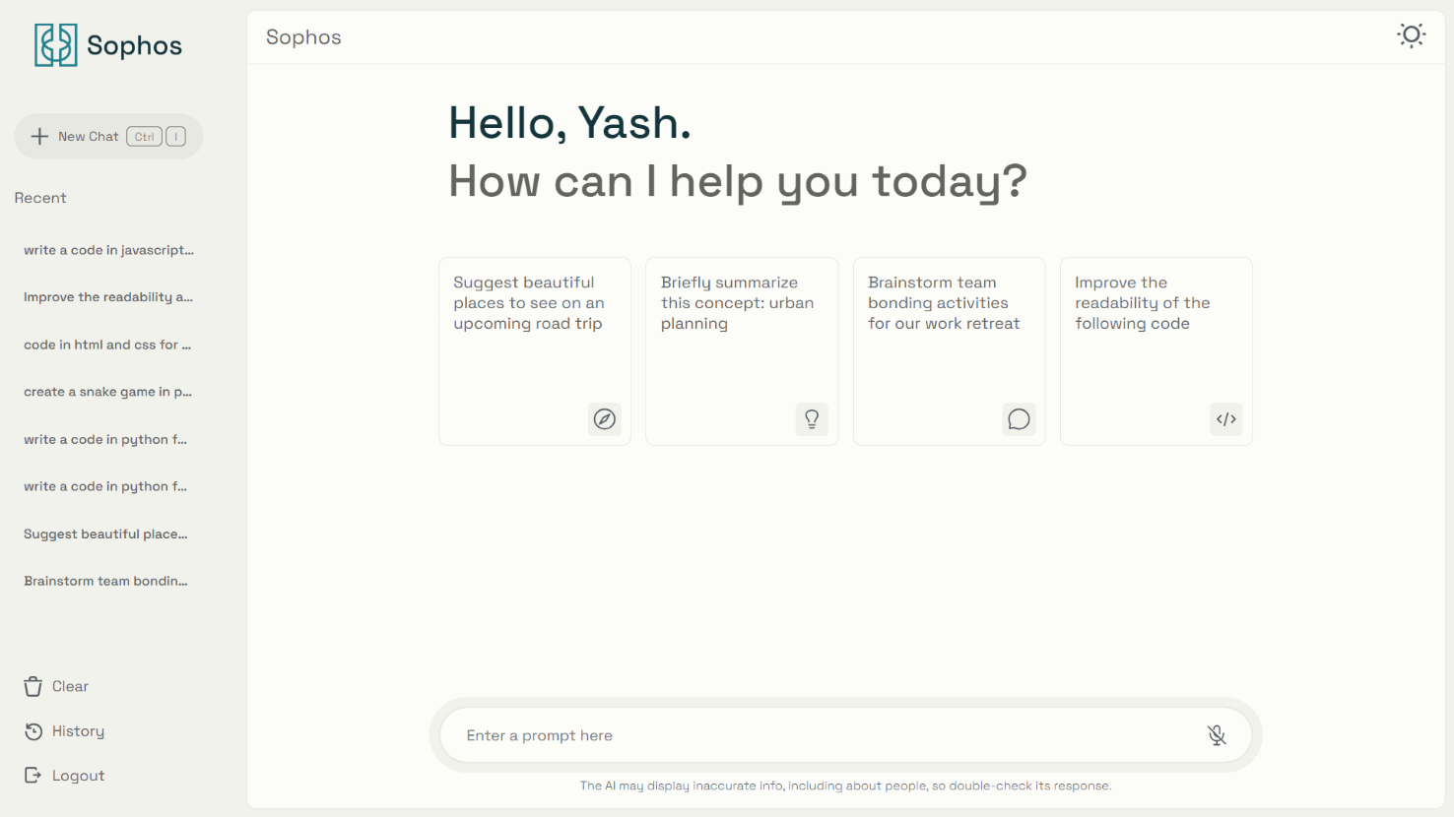
Dashboard Page

Slide 15
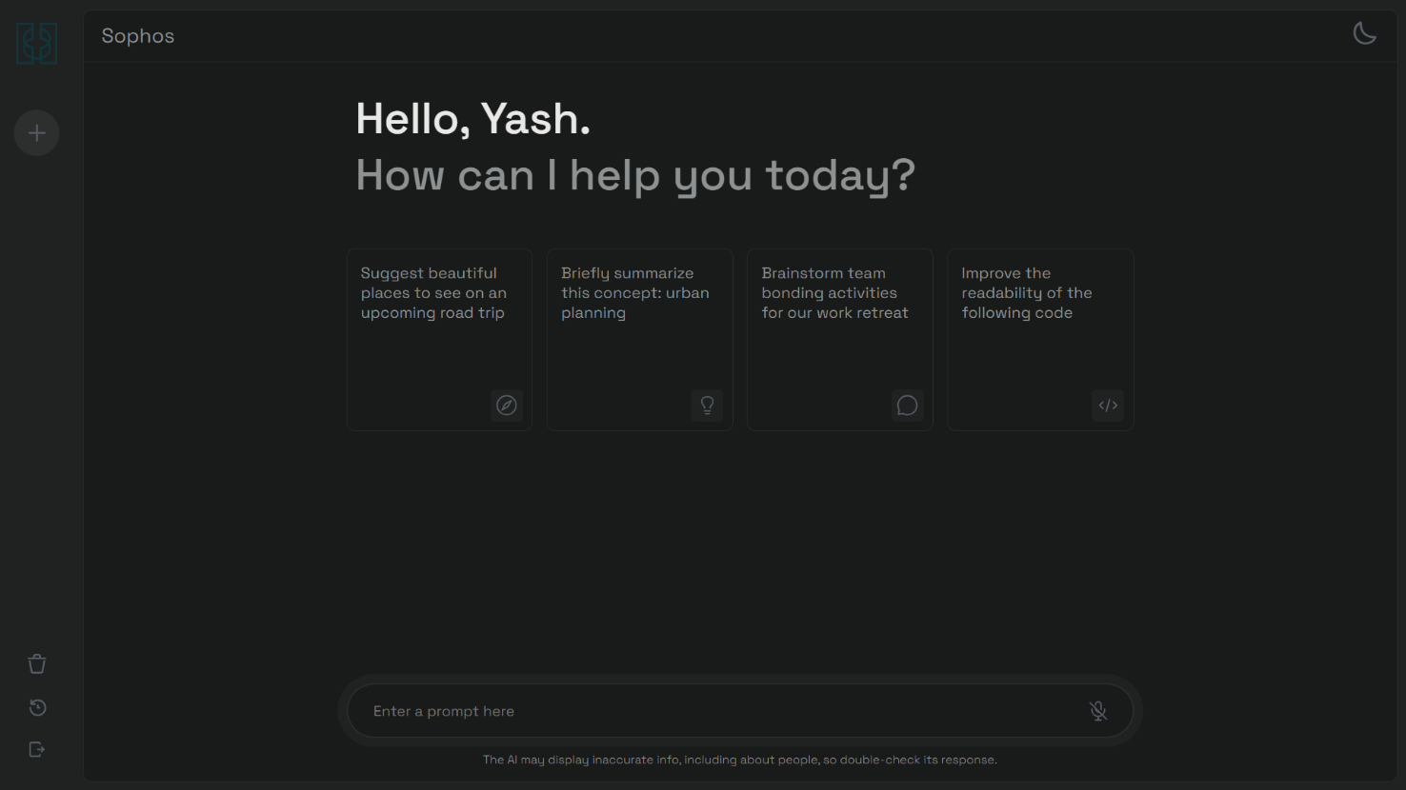
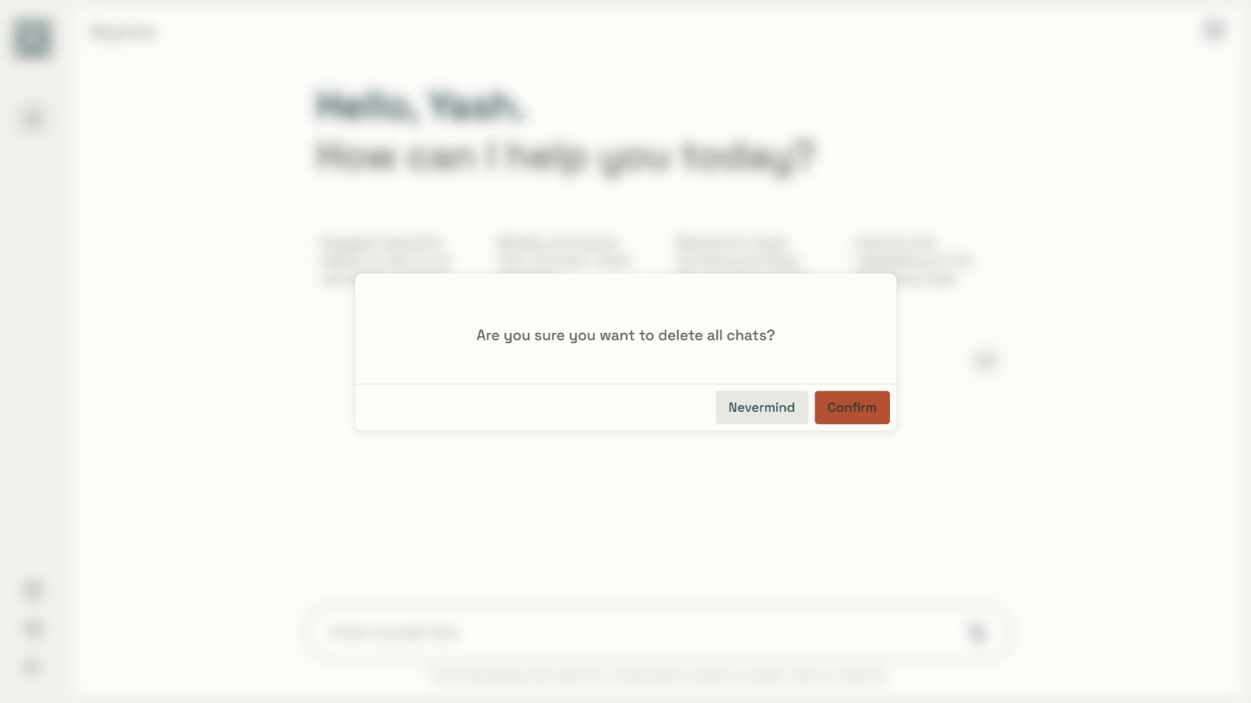
Dark Mode & Pop-up

Slide 16
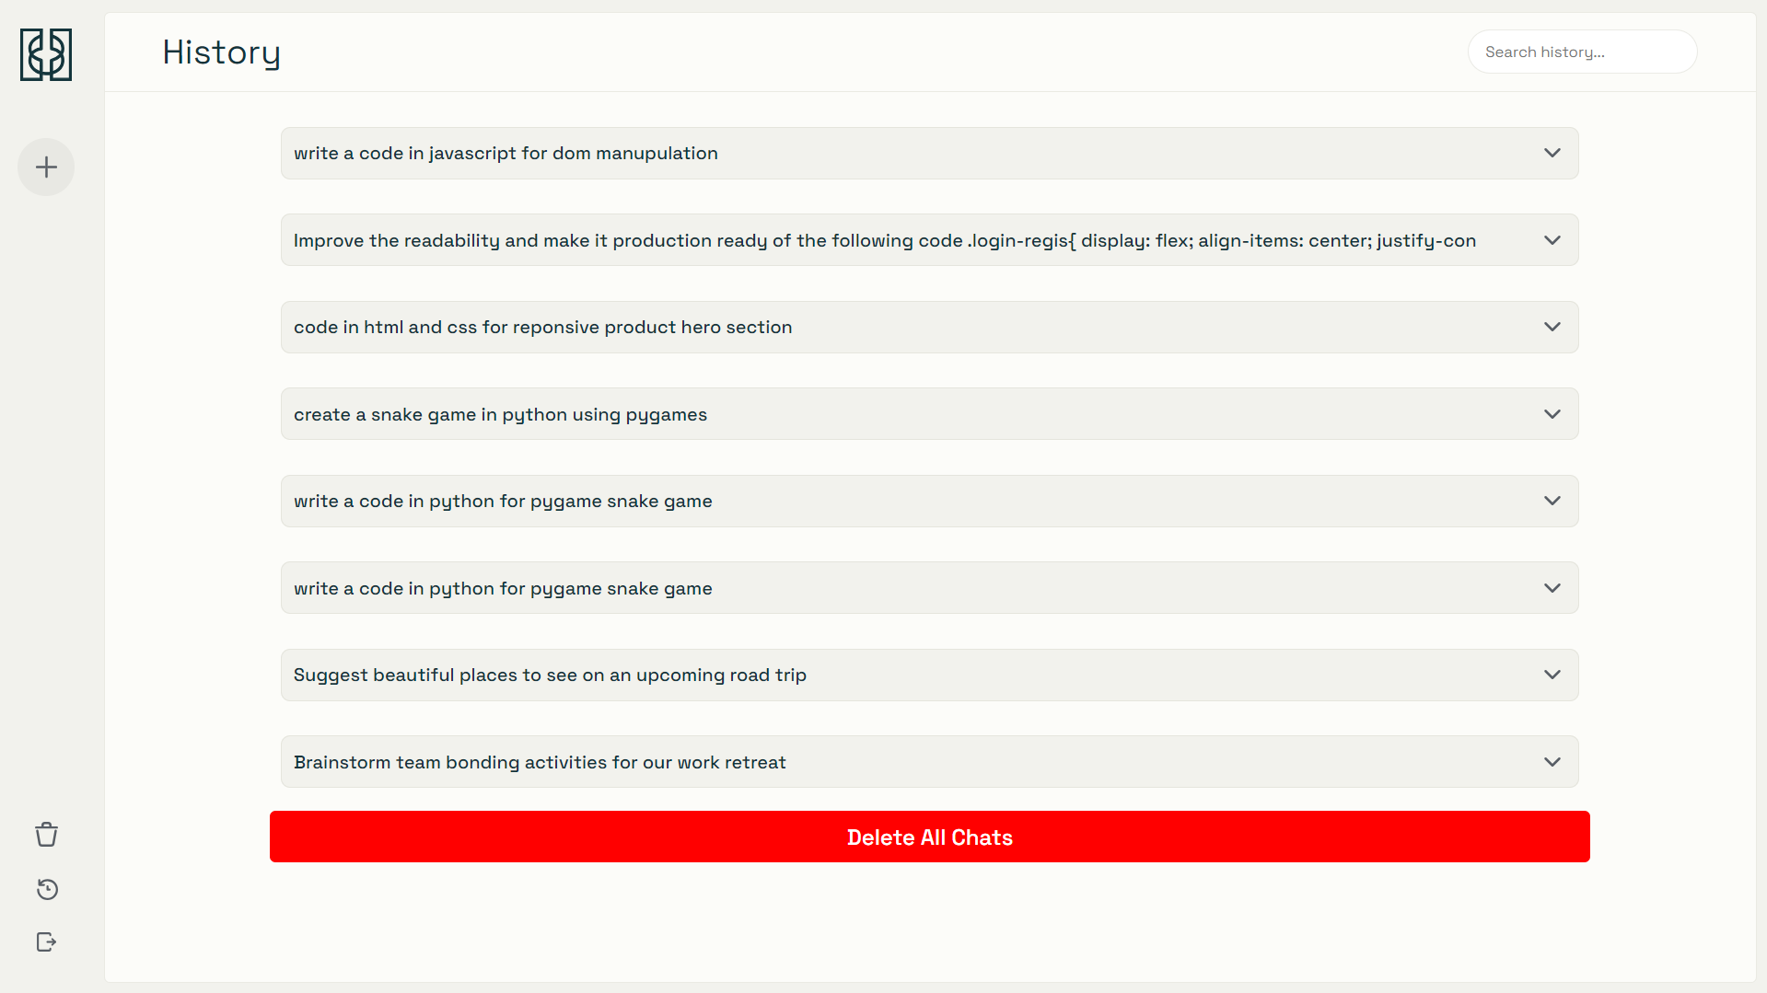
History Page

Slide 17
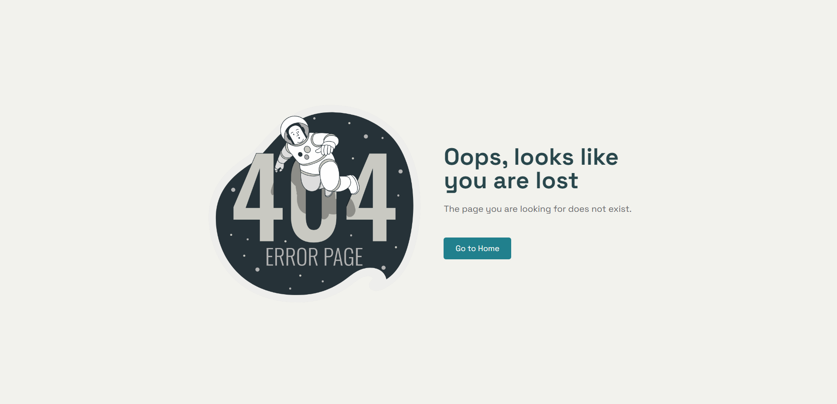
ERROR 404 Page

Slide 18

Conclusion
The project delivers a secure and responsive platform for managing user queries and interactions. It integrates modern technologies like React, Node.js, and MongoDB, with secure authentication and search history tracking. Using the Gemini API for AI-driven responses, the system ensures scalability, performance, and an engaging user experience.

Slide 19

References
1
React.js Documentation
https://react.dev/learn
2
Node.js Documentation
https://nodejs.org/docs/latest/api
3
Express.js Documentation
https://expressjs.com/en/guide/routing.html
4
MongoDB Documentation
https://www.mongodb.com/docs/manual
5
Gemini API Documentation
https://ai.google.dev/gemini-api/docs
6
JWT Documentation
https://jwt.io/introduction

Slide 20
Thank You!
For Your Time

